Slide 1








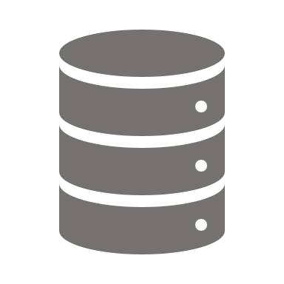






 | ”name”: ”APIOps® Cycles Design Book”, ”description": ”APIOps® Cycles is a Lean Method for Designing and Managing API Products",
 | ”audience”: [”Business Developers”, ”Product Managers”, ”Architects”, ”Developers”, ”Integration specialists”],
 | ”version": ”1.1-beta", ”authors":[”Marjukka Niinioja, Digia Oyj”, ”Turo Hyppönen Digia Oyj”]
API Canvas
Learn
Min. Viable API Architecture
APIOps® Cycles
Measure
Build APIs
Developer Experience
API Audit
API Lifecycle

Slide 2
Overview
What is APIOps® Cycles?
What can I do with API Canvas?
The APIOps© Cycles is a set of tools and methods originally created by Digia. The tools and methods are designed to help all organizations and individuals to build great APIs.
APIOps©Cycles method uses a re-interpreted version of an API Canvas. We have added our experience to the model which is a form of popular business model canvas.
You can learn and adapt the method to your API needs either on your own or with API consultants.
The APIOps© Cycles method uses modern and proven frameworks with a twist of our experience to fit them for APIs. All methods have a Lean management base: Business Model Canvas, Value Proposition Canvas, Lean Startup, Minimum Viable Architecture and DevOps .
The method fits also in an organization where the working methods are not yet very lean or agile. Or at least there is a clear separation of development and operations. The main benefit of the methods is that they enforce communication. APIOps© Cycles helps communication between different business roles and different IT roles.
First method is API Canvas, i.e. making sure we know what benefits come and to who for using the API. The Canvas helps to define the key features of the API. It also clarifies what we need to build to make the API real.
Main benefit of API Canvas compared to for example project scoping tools is that it treats the API as a product. This means that it tries to find the needs of several API Consumer segments, not just the one at hand.
It also directs user to think how to communicate and support the API Consumers and give them access to the API. It also focuses on how to make money, added value like customer retention or cost savings with the API.
Start with the API Value Proposition Canvas. It’s a great interviewing tool. Use it when finding and validating requirements with API Consumers.
Digia API Canvas has 9 areas, which have almost the same titles as in Business Model Canvas. API Canvas is the master document for next phases, including architecture design.
You should share the API Canvas with all relevant stakeholders. This includes external developers and other partners you need to work with. The simpler API Value Proposition Canvas helps to create value proposition and related information to the API Canvas.

Slide 3
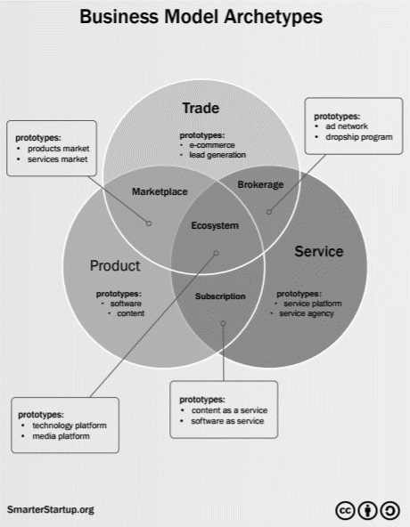
Why APIs are a business issue?
Because APIs make all business models possible
APIs can bring additional value to customers and partners allowing them to access their own data or use your services via their own interfaces
API is a product which can be sold, commonly with a subscription or value based model
Ecosystem can provide and consume APIs to create a unified, complete customer journey and share value
APIs can be sold on a marketplace. They enable physical and digital products and services to be sold on a marketplace
APIs used by ecosystem to create their own innovation solutions which can be used as a lead generation channel
APIs can handle orders, payments and logistics enabling e-commerce solutions based on APIs

Slide 4
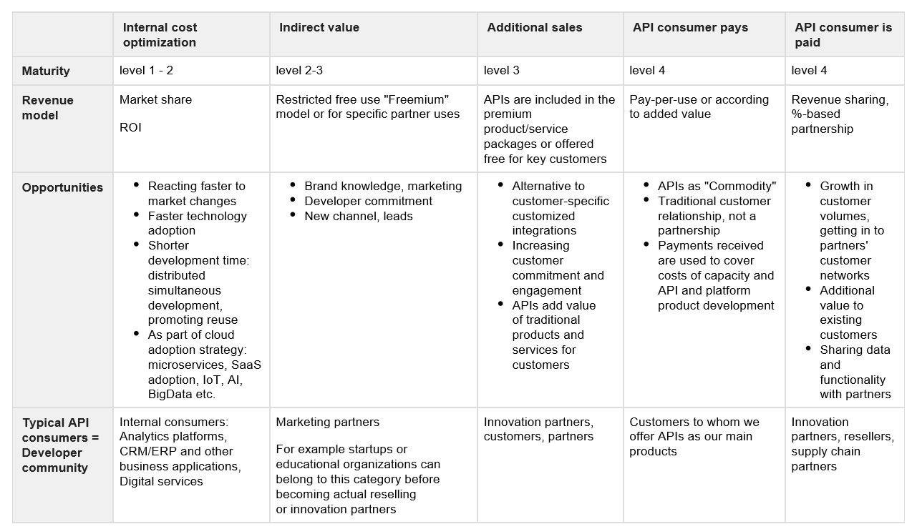
API Business Models in a nutshell

Slide 5
UX for UI design vs. UX for API design
Research
Insight
UX vision
Concept
Design and build
Business, vision, goals, brands
Task models, user stories, personas
Brainstorming user needs, business goals, tech solutions
Validate, refine, Prototypes, Wireframes
Detailed design, code, monitor results
Technical lifecycle needs, non-func requirements
API consumers are organizations, systems & teams of developers
OpenAPI files, schemas = ”wireframes”, generated uis, chatbots etc.
Validating with API consumers, ”mocking”, load testing
API lifecycle: publish, version, depricate, migrate to API mgmt

Slide 6
APIOPS Cycle for all changes
Breaking changes
New features
Depricating endpoints
Fixes to existing requirements
API Canvas
Update
API Canvas
Learn
Min. Viable API Architecture
Learn
Adjust Min. Viable API Architecture
Learn
Measure
Building APIs
Major 1.0.0
Minor 1.1.0
Patch 1.1.1
Measure
Build APIs
Measure
Build APIs
Developer Experience
API Audit
Developer Experience
API Audit
API Lifecycle
Developer Experience
API Audit
API Lifecycle
API Lifecycle

Slide 16
APIs <> integrations
0-N API Consumers
1-N backend services
0-N data storage, can just perform algorithm
1-few integration parties
1 backend
Typically 1+1 data storages
Private networks,
TCP etc. protocols
Mostly secure consumers, backends and network
Huge payloads of data at intervals
Public internet,
HTTP(S)
Mostly insecure consumers, backends and network
Small payloads of data often
System
API
IoT device
Integration OUT
Integration IN
Micro-service
Smart contract
Integration IN/OUT
Chatbot
System
System

Slide 17
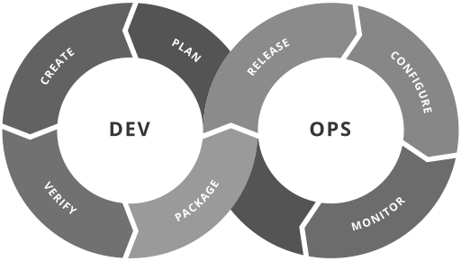
APIs need DevOps x2: Interface + Implementation
Plan API business model, API consumer requirements, interfaces, API mgmt, code
Release both API interface and code which implements it
Configure API interface, management & code environment
Create, verify and package API interface & code which implements it
Monitor API performance, code, developer experience & business metrics
By Kharnagy - Own work, CC BY-SA 4.0

Slide 18
APIOPS Cycle for all changes
Breaking changes
New features
Depricating endpoints
Fixes to existing requirements
API Canvas
Update
API Canvas
Learn
Min. Viable API Architecture
Learn
Adjust Min. Viable API Architecture
Learn
Measure
Building APIs
Major 1.0.0
Minor 1.1.0
Patch 1.1.1
Measure
Build APIs
Measure
Build APIs
Developer Experience
API Audit
Developer Experience
API Audit
API Lifecycle
Developer Experience
API Audit
API Lifecycle
API Lifecycle

